Slide 1
Foundations of Machine Learning
Module 3: Instance Based Learning and Feature Reduction
Part B: Feature Selection
Sudeshna Sarkar
IIT Kharagpur

Slide 2
Feature Reduction in ML
The information about the target class is inherent in the variables.
Naïve view: More features => More information => More discrimination power.
In practice: many reasons why this is not the case!

Slide 3
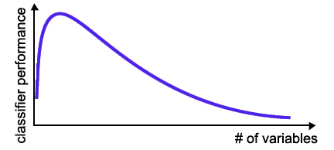
Curse of Dimensionality
number of training examples is fixed
=> the classifier’s performance usually will degrade for a large number of features!

Slide 4
Feature Reduction in ML
Irrelevant and
redundant features
can confuse learners.
Limited training data.
Limited computational resources.
Curse of dimensionality.

Slide 5
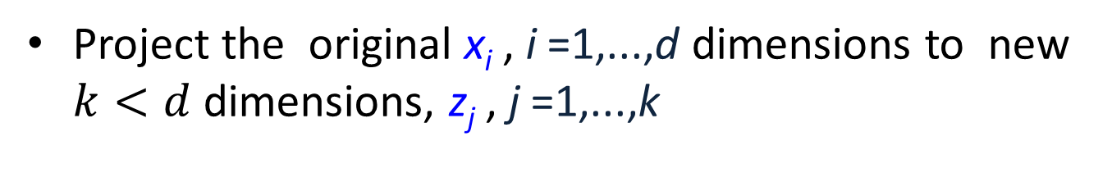
Feature Selection
Problem of selecting some subset of features, while ignoring the rest
Feature Extraction
Project the original x_{i} , i =1,...,d dimensions to new $k<d$dimensions, z_{j} , j =1,...,k
Criteria for selection/extraction:
either improve or maintain the classification accuracy, simplify classifier complexity.

Slide 6
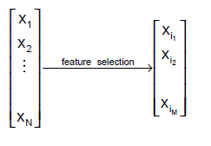
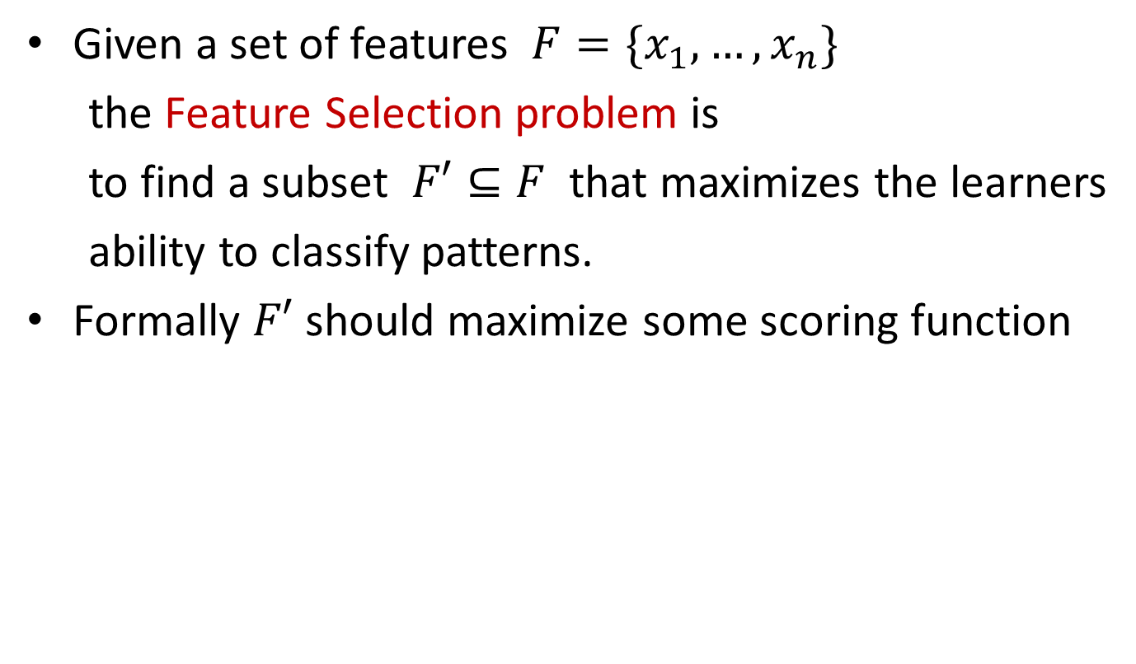
Feature Selection - Definition
Given a set of features $F=\{x_{1}, …,x_{n}\}$
the Feature Selection problem is
to find a subset $F′⊆F$ that maximizes the learners
ability to classify patterns.
Formally $F′$ should maximize some scoring function

Slide 7
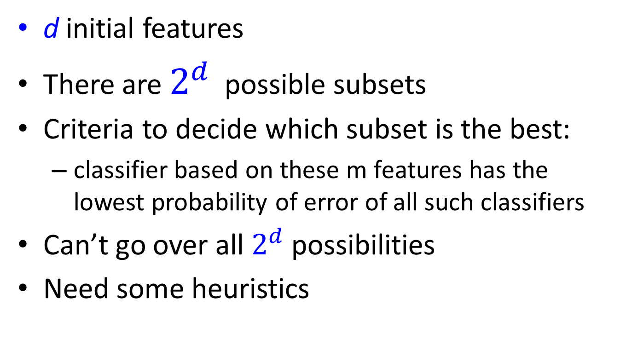
Subset selection
d initial features
There are $2^{d}$ possible subsets
Criteria to decide which subset is the best:
classifier based on these m features has the lowest probability of error of all such classifiers
Can’t go over all $2^{d}$ possibilities
Need some heuristics

Slide 8
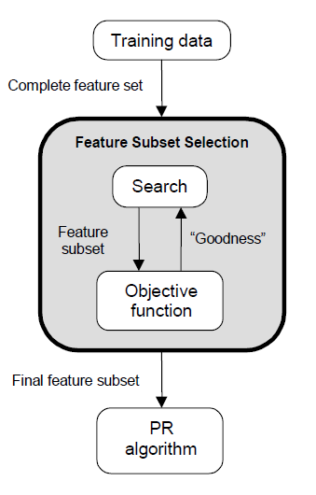
Feature Selection Steps
Feature selection is an optimization problem.
Step 1: Search the space of possible feature subsets.
Step 2: Pick the subset that is optimal or near-optimal with respect to some objective function.

Slide 9
Feature Selection Steps (cont’d)
Search strategies
Optimum
Heuristic
Randomized
Evaluation strategies
Filter methods
Wrapper methods

Slide 10
Evaluating feature subset
Supervised (wrapper method)
Train using selected subset
Estimate error on validation dataset
Unsupervised (filter method)
Look at input only
Select the subset that has the most information

Slide 11
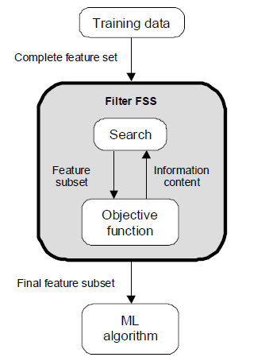
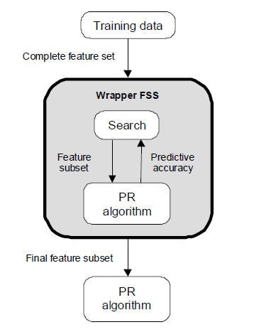
Evaluation Strategies
Filter Methods
Wrapper Methods

Slide 12
Subset selection
Select uncorrelated features
Forward search
Start from empty set of features
Try each of remaining features
Estimate classification/regression error for adding specific feature
Select feature that gives maximum improvement in validation error
Stop when no significant improvement
Backward search
Start with original set of size d
Drop features with smallest impact on error

Slide 13
Feature selection
Univariate (looks at each feature independently of others)
Pearson correlation coefficient
F-score
Chi-square
Signal to noise ratio
mutual information
Etc.
Rank features by importance
Ranking cut-off is determined by user
Univariate methods measure some type of correlation between two random variables
the label (y_{i}) and a fixed feature (x_{ij} for fixed j)

Slide 14

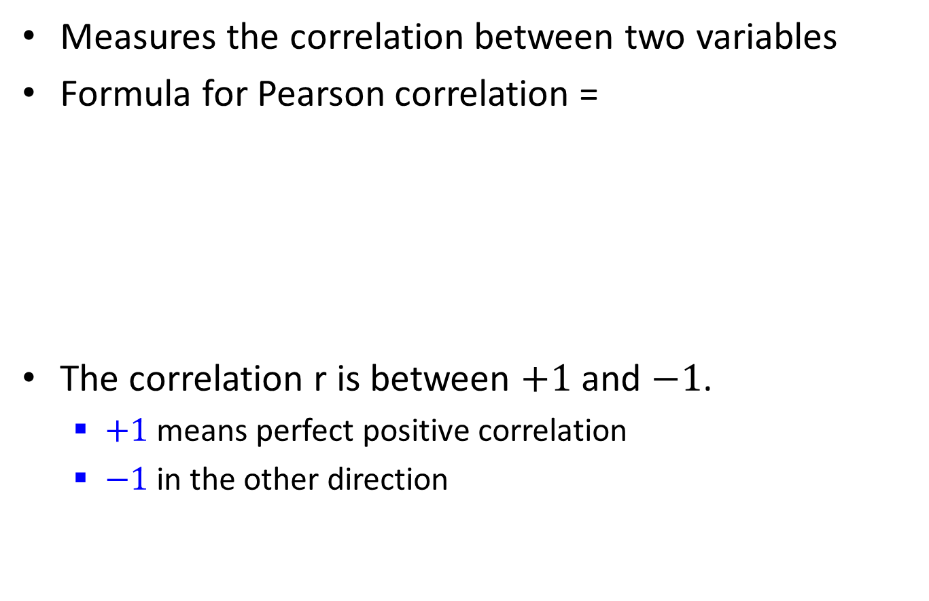
Pearson correlation coefficient
Measures the correlation between two variables
Formula for Pearson correlation =
The correlation r is between $+1$ and $−1$.
$+1$ means perfect positive correlation
$−1$ in the other direction

Slide 15
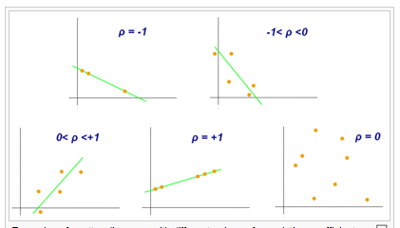
Pearson correlation coefficient
From Wikipedia

Slide 16
Signal to noise ratio
Difference in means divided by difference in standard deviation between the two classes
S2N(X,Y) = (μ_{X} - μ_{Y})/(σ_{X} – σ_{Y})
Large values indicate a strong correlation

Slide 17
Multivariate feature selection
Multivariate (considers all features simultaneously)
Consider the vector w for any linear classifier.
Classification of a point x is given by w^{T}x+w₀.
Small entries of w will have little effect on the dot product and therefore those features are less relevant.
For example if w = (10, .01, -9) then features 0 and 2 are contributing more to the dot product than feature 1.
A ranking of features given by this w is 0, 2, 1.

Slide 18
Multivariate feature selection
The w can be obtained by any of linear classifiers
A variant of this approach is called recursive feature elimination:
Compute w on all features
Remove feature with smallest w_{i}
Recompute w on reduced data
If stopping criterion not met then go to step 2

Slide 19
Feature Extraction

Slide 20
Foundations of Machine Learning
Module 3: Instance Based Learning and Feature Reduction
Part C: Feature Extraction
Sudeshna Sarkar
IIT Kharagpur

Slide 21
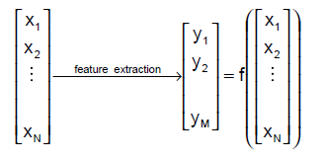

Feature extraction - definition
Given a set of features $F=\{x_{1}, …,x_{N}\}$
the Feature Extraction(“Construction”) problem is
is to map $F$ to some feature set $F′′$ that maximizes the learner’s ability to classify patterns

Slide 22
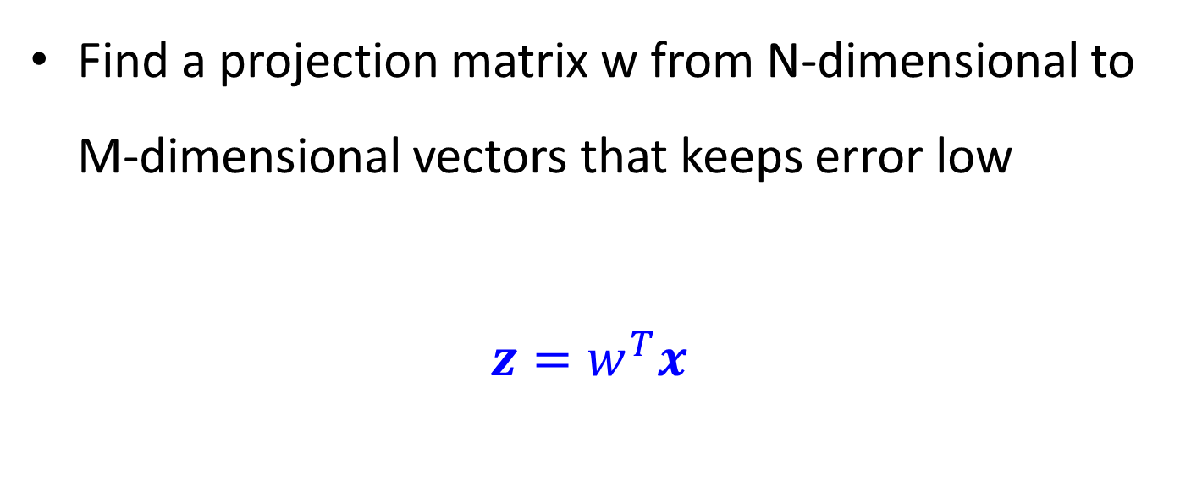
Feature Extraction
Find a projection matrix w from N-dimensional to M-dimensional vectors that keeps error low
$$z=w^{T}x$$

Slide 23
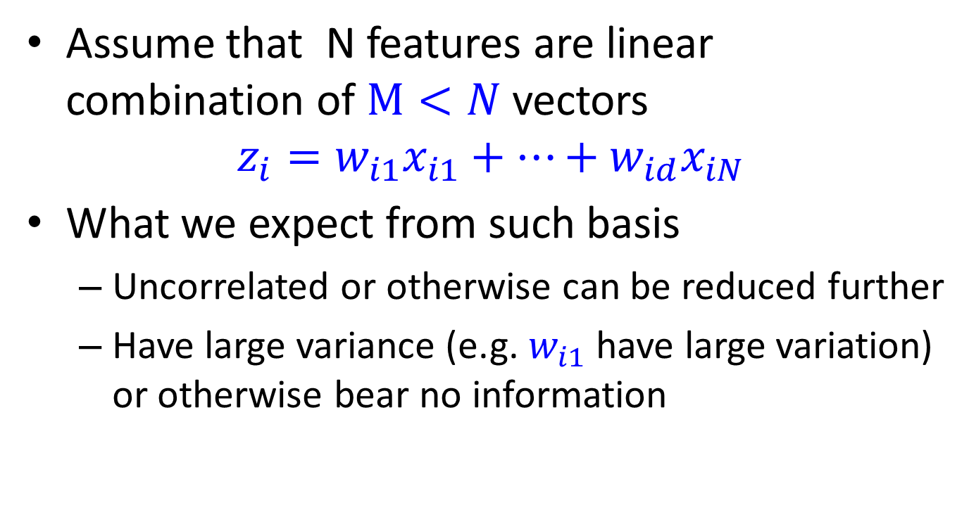
PCA
Assume that N features are linear combination of $M<N$ vectors
$$z_{i}=w_{i1}x_{i1}+…+w_{id}x_{iN}$$
What we expect from such basis
Uncorrelated or otherwise can be reduced further
Have large variance (e.g. $w_{i1}$ have large variation) or otherwise bear no information

Slide 24
Geometric picture of principal components (PCs)

Slide 25
Geometric picture of principal components (PCs)

Slide 26
Geometric picture of principal components (PCs)

Slide 27
Algebraic definition of PCs
Given a sample of p observations on a vector of N variables
define the first principal component of the sample
by the linear transformation
where the vector
is chosen such that
is maximum.

Slide 28
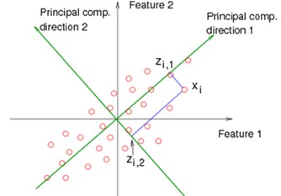
PCA

Slide 29
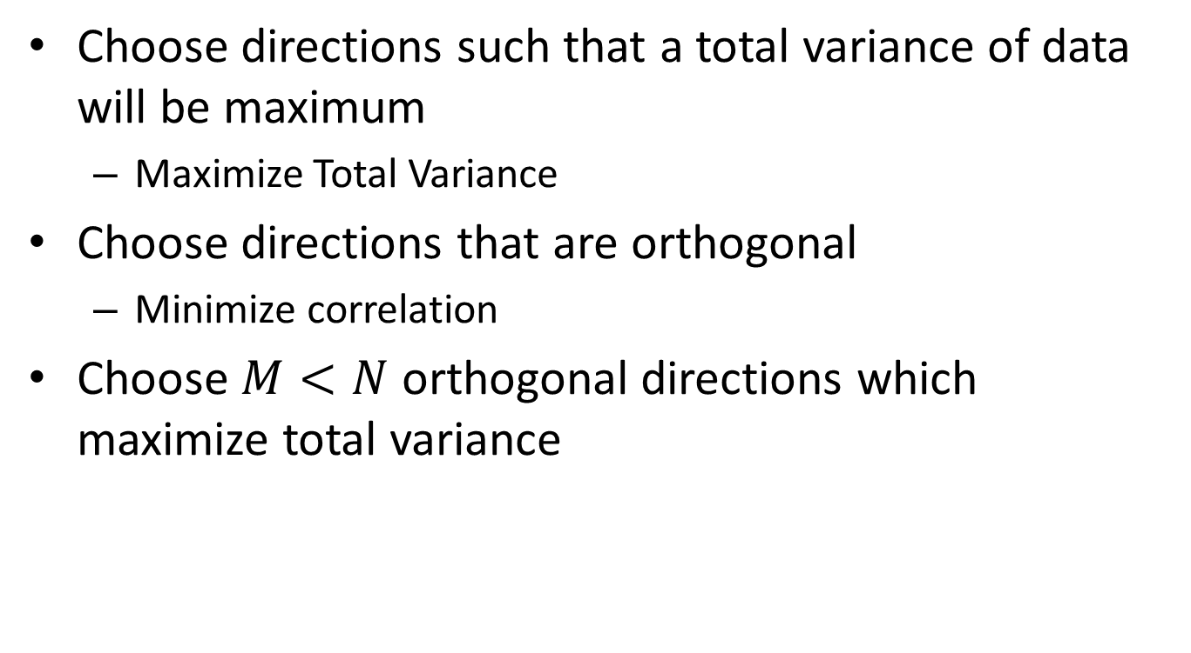
Choose directions such that a total variance of data will be maximum
Maximize Total Variance
Choose directions that are orthogonal
Minimize correlation
Choose $M<N$ orthogonal directions which maximize total variance

Slide 30
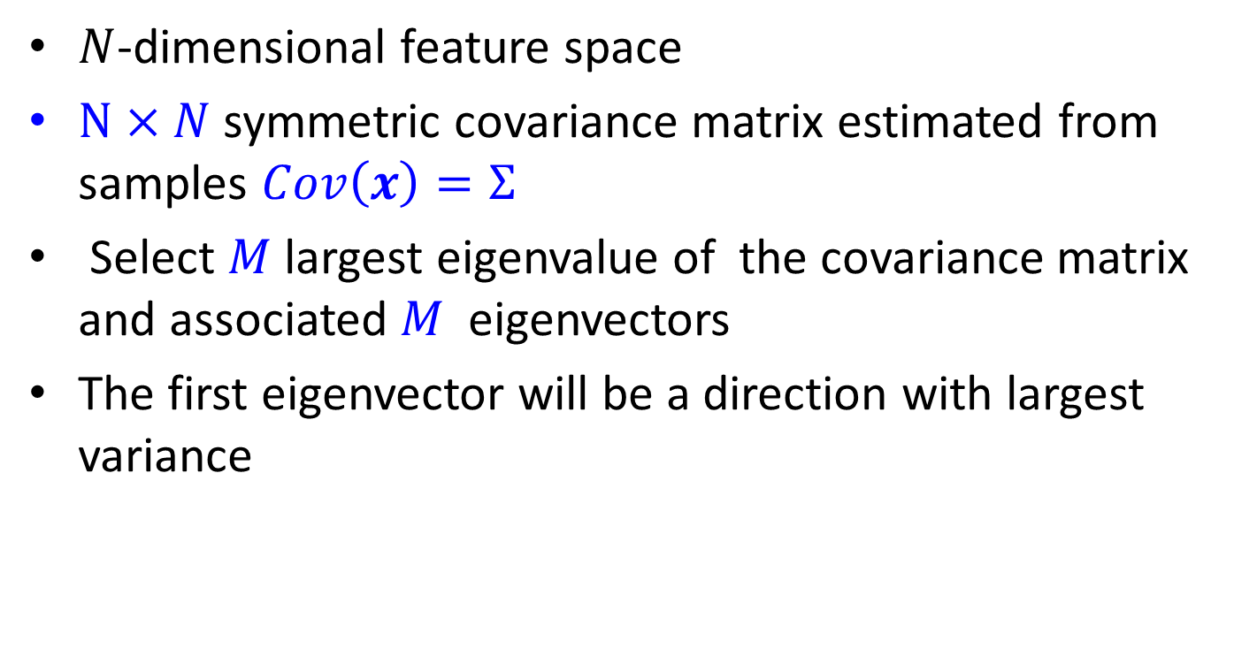
PCA
$N$-dimensional feature space
$N×N$ symmetric covariance matrix estimated from samples $Cov\left(x\right)=Σ$
Select $M$ largest eigenvalue of the covariance matrix and associated $M$ eigenvectors
The first eigenvector will be a direction with largest variance

Slide 31
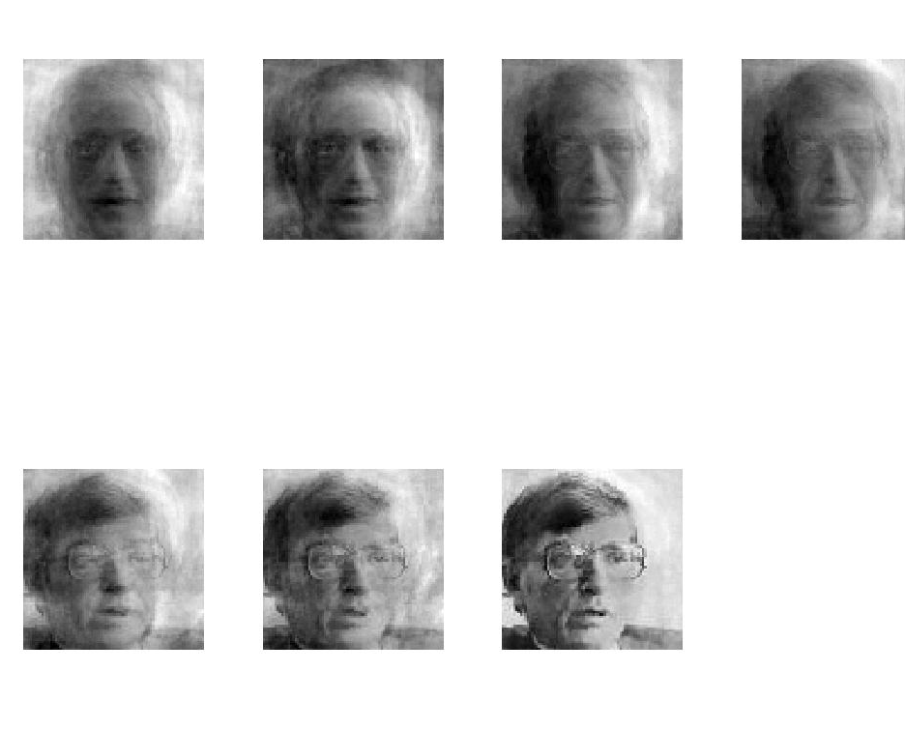
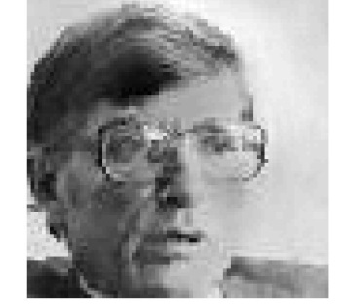
PCA for image compression
p=1
p=2
p=4
p=8
Original Image
p=16
p=32
p=64
p=100

Slide 32
Is PCA a good criterion for classification?
Data variation determines the projection direction
What’s missing?
Class information

Slide 33
What is a good projection?
Similarly, what is a good criterion?
Separating different classes
Two classes overlap
Two classes are separated

Slide 34
What class information may be useful?
Between-class distance
Distance between the centroids of different classes
Between-class distance

Slide 35
What class information may be useful?
Between-class distance
Distance between the centroids of different classes
Within-class distance
Accumulated distance of an instance to the centroid of its class
Linear discriminant analysis (LDA) finds most discriminant projection by
maximizing between-class distance
and minimizing within-class distance
Within-class distance

Slide 36
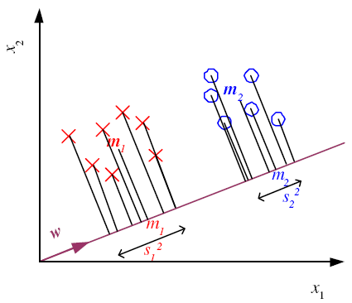
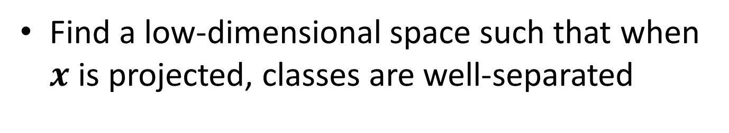
Linear Discriminant Analysis
Find a low-dimensional space such that when $x$ is projected, classes are well-separated

Slide 37
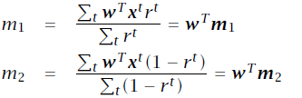
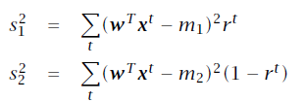
Means and Scatter after projection

Slide 38
Good Projection
Means are as far away as possible
Scatter is small as possible
Fisher Linear Discriminant

Slide 40
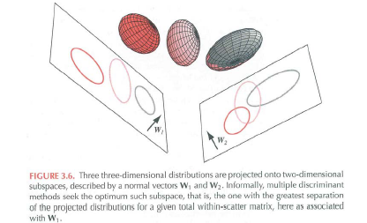

Multiple Classes
For $c$ classes, compute $c−1$ discriminants, project N-dimensional features into $c−1$ space.

